Slide 1

Vault
A SHARED DISTRIBUTED AND REDUNDANT STORAGE SOLUTION
Progress so far...

Slide 2
Group
TRNR Peiris - IT 16106420
KVA Sachintha - IT 16158528
BA Ganegoda
WMUKMT Bandara-IT16091276

Slide 3
Node Authentication, encryption and File Sharing module (BA Ganegoda)
Encryption and decryption functions in progress(symmetric encryption) (50%)
Sharing part was broken down into two parts as Public and private sharing and not yet started
User authentication in progress(50%)
Node authentication and integrity validation not yet started.
Content based search algorithm for faster file search is in mind.

Slide 4
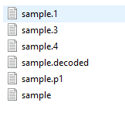
File Redundancy and Disk Health Monitoring (TRNR Peiris)
One file scattered into 4 data shards - Completed
Generating parity shards - Completed
Regenerating file from any 4 out of 6 shards available at the time - Completed
Reducing the amount of space required for a parity shard - In progress
Size of a parity shard = size of a shard + size of a shard /8 Completed
Size of a parity shard = size of a shard - In Progress
Performance optimization - In progress

Slide 5
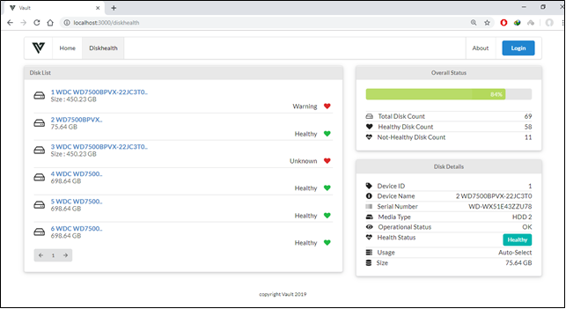
Disk Health Identification
Modern hard drives have “S.M.A.R.T..” It’s a feature that allows operating systems
(like Linux, Mac, and Windows)
to verify the integrity and health of the hard drives.
Widows - Tested
Linux - Tested
MacOS - Scheduled
Frontend - Completed

Slide 6
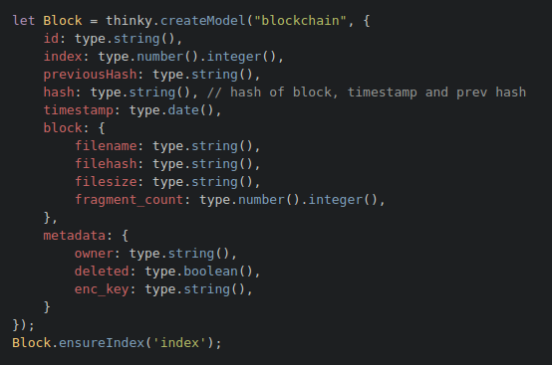
Blockchain based DHT and Messaging Protocol (KVA Sachintha)
Blockchain core logic complete.
Block Verification complete.
Functions for calculating Merkle root in progress.
Blocks are currently persisted to a NoSQL database.
Advantages of using an RDBMS is still in mind.
Currently designing the API that is eventually going to be exposed

Slide 7
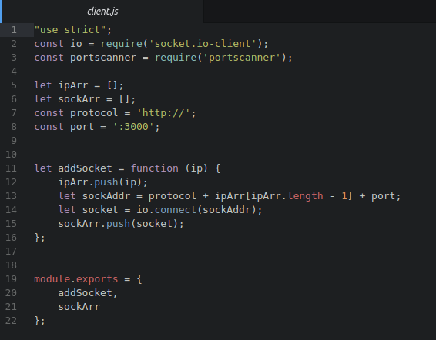
Messenger Module
Uses Socket.io transport for websocket based 2 way communication
Uses 2 channels
For Blockchain updates
For Configuration updates
Currently testing automatic detection of messenger service via portscan.
Currently formulating a Consistent Messenger API for external modules to use.
Currently testing various heartbeat intervals vs performance degradations.

Slide 8
Static and Dynamic Disk Space Allocation methodology (WMUKMT Bandara)
Virtual hard disk creations.
create virtual disk vmalloc() function. (in progress)
Location initialized to 0 memset(). (in progress)
Develop a device driver for virtual hard disk. (not yet implement)
Device files operations
Read / write is implemented using memcpy() API. (Not yet implement)
Block operation. (in progress)
The request function to process the requests in the request queue.
The spin lock associated with the request queue to protect concurrent access.
Disk status monitoring. (front end complete)

Slide 9
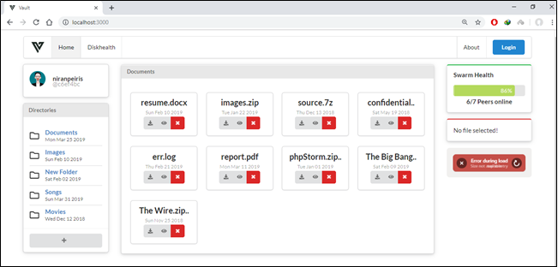
Main UI - Normal Users Interface

Slide 10
Main UI - Disk Health

Slide 11
Thank you!

